Slide 1
Object-Oriented Programming (CS 217)
Jawad Hassan Nisar
16-09-2020
Department of Computer Science,
National University of Computer & Emerging Sciences, Islamabad Campus

Slide 2
1. Contac Information
Contact Information:
Office: 202B (2nd Floor, Block-C)
Phone Ext: 630
Email: jawad.hassan@nu.edu.pk
Consultation Hours (OOP):
Monday-Thursday 11:30 to 12:50

Slide 3
2. Course Objectives
The course aims to provide students with the ability to analyze the given requirements for solving problems in different domains and to implement the solutions on a computer system.
It mainly emphasizes applying the object-oriented programming (OOP) principles and the need to separate the interface from the implementation.
The students will learn the syntax and control structures of the C++ programming language for the implementation.

Slide 4
3. Course Learning Outcomes
Understand the object-oriented programming principles
Design a software system of a reasonable size for a real-life problem
Apply the OOP principal to implement a project and formally present the work.

Slide 5
4. Contents and Organization

Slide 6
4. Contents and Organization

Slide 7
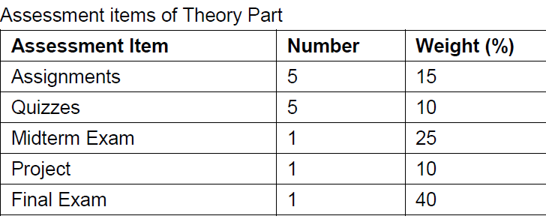
5. Grading Policy
Grading policy: combined result of all OOP sections

Slide 8
6. Literature & Acknowledgement
Text Book:
Tony Gaddis, Starting Out with C++ from Control Structures to Objects (8th Edition) Publisher: Pearson; 8 edition
Reference Book:
Paul Deitel, Harvey Deitel "C++ How to Program" 10th Edition
Walter Savitch "Problem Solving with C++" 10th Edition
D. S. Malik "C++ Programming: From Problem Analysis to Program Design" 8th Edition

Slide 9
7. OOP Class Material and Queries
Google Classroom:
mt3kuyp

Slide 10
8. Class Policies and Guidelines
Attendance policy:
Will be taken at the start of the class. Students appearing late in the class after the attendance will be marked “Absent”

Slide 11
8. Class Policies and Guidelines

Slide 12
8. Class Policies and Guidelines

Slide 13
8. Class Policies and Guidelines
Don’ts
Use of cell phones
Discussion with fellows during class
Early leave
Frequent movements In-out of class
Do’s
Be interactive, ask questions
Participate in the lecture, relax, and learn

Slide 14
Any Questions ?

